Slide 1
Network Security Review
Review Week Day 2

Slide 3
Class Objectives
In today’s class, we will review Linux by:
Design and implement firewall policies with UFW
Use Wireshark to analyze malicious traffic
Schedule backups with cron and tar to protect availability

Slide 4
Class Overview
Today’s class revolves around four exercises covering fundamental network security topics:
Exercise 1: Firewall Policies
Exercise 2: Sniffing Web Attacks
Exercise 3: Interpreting Snort Rules
Exercise 4: Scheduling Back-Ups

Slide 5
Firewall Policies

Slide 6
Exercise 1: Firewall Policies
For this activity you will work with a partner to design and implement a firewall policy by:
Determining which services each machine provides
Determining which ports those services require
Designing and documenting a firewall policy for each machine
Implementing the policy on each machine

Slide 7
Your Turn: Firewall Policies
In this activity, you will play the role of a network administrator responsible for securing a network. You will determine which services should be available, determine which ports they require, and then configure firewalls to expose only those ports..
Instructions sent via Slack
20 Minutes

Slide 8
Firewall Policies

Slide 9
Firewall Policies Review: Auditing
1. Service-Level Agreements for the company's intranet
Description: Web server that provides access to organization's IAM database.
This machine runs an HTTP and HTTPS server, which should be available to all machines on the subnet.
There is also an SSH listener, which should only allow access from the command server.
Disable connections to all other running services.
User Data API
Service(s): __________
Port(s): __________
User Database
Service(s): __________
Port(s): __________
Command Server
Service(s): __________
Port(s): __________

Slide 10
Firewall Policies Review: Auditing
1. Service-Level Agreements for the company's intranet
Description: Web server that provides access to organization's IAM database.
This machine runs an HTTP and HTTPS server, which should be available to all machines on the subnet.
There is also an SSH listener, which should only allow access from the command server.
Disable connections to all other running services.
User Data API
Service(s): HTTP, SSH, HTTPS
Port(s): 22, 80, 443
User Database
Service(s): __________
Port(s): __________
Command Server
Service(s): __________
Port(s): __________
Notes:
The description indicates the server should expose SSH/22, HTTP/80, and HTTPS/443.
The final note indicates these are the only ports that should be exposed.

Slide 11
Firewall Policies Review: Auditing
1. Service-Level Agreements for the company's intranet
Description:
MySQL server containing user data for IAM policies.
Should only be accessible by the User Data API server.
User Data API
Service(s): HTTP, HTTPS
Port(s): 80, 433
User Database
Service(s): __________
Port(s): __________
Command Server
Service(s): __________
Port(s): __________

Slide 12
Firewall Policies Review: Auditing
1. Service-Level Agreements for the company's intranet
Description:
MySQL server containing user data for IAM policies.
Should only be accessible by the User Data API server
User Data API
Service(s): HTTP, HTTPS
Port(s): 80, 433
User Database
Service(s): MySQL
Port(s): 3360
Command Server
Service(s): __________
Port(s): __________
Notes:
The description indicates the DB should expose MySQL/3360. Note that students (probably) had to Google this answer.
The description also indicates the firewall should only allow connections from the IP Address of the User Data API server.

Slide 13
Firewall Policies Review: Auditing
1. Service-Level Agreements for the company's intranet
Description:
Server responsible for controlling whether other servers on the network are up or down.
Allows administrators to login remotely to issue commands.
Block all requests to the telnet server that do not come from the local subnet.
Allow outgoing SSH and telnet connections to other machines within the subnet.
User Data API
Service(s): HTTP, HTTPS
Port(s): 80, 433
User Database
Service(s): MySQL
Port(s): 3360
Command Server
Service(s): __________
Port(s): __________

Slide 14
Firewall Policies Review: Auditing
1. Service-Level Agreements for the company's intranet
Description:
Server responsible for controlling whether other servers on the network are up or down.
Allows administrators to login remotely to issue commands.
Block all requests to the telnet server that do not come from the local subnet.
Allow outgoing SSH and telnet connections to other machines within the subnet.
User Data API
Service(s): HTTP, HTTPS
Port(s): 80, 433
User Database
Service(s): MySQL
Port(s): 3360
Command Server
Service(s): SSH, Telnet
Port(s): 22, 23
Notes:
The description indicates the server should expose SSH/22 and Telnet/23.
The firewall should only allow connections to ports 22 and 23 from IP Addresses in the local subnet range.

Slide 15
Firewall Policies Review: Generating Documentation
Generate documentation by implementing the firewall and exporting you rules.
Create a directory to save firewall information in: ~/security/firewall_policies. Move into this directory.
Create a new file for each machine—e.g., command_server.ufw.rules.
Write the UFW commands you would run to implement the correct firewall rules in each file.

Slide 16
Firewall Policies Review: Generating Documentation
Complete the following support documentation:
Create a directory to save firewall information in: ~/security/firewall_policies. Move into this directory.
Create a new file for each machine—e.g., command_server.ufw.rules.
Write the UFW commands you would run to implement the correct firewall rules in each file.
Solution:
$ mkdir -p ~/security/firewall_policies
$ cd ~/security/firewall_policies
$ touch command_server.ufw.rule api_server.ufw.rules userdb.ufw.rules

Slide 17
Firewall Policies Review: Generating Documentation
Complete the following support documentation:
Create a directory to save firewall information in: ~/security/firewall_policies. Move into this directory.
Create a new file for each machine—e.g., command_server.ufw.rules.
Write the UFW commands you would run to implement the correct firewall rules in each file.
Solution:
$ mkdir -p ~/security/firewall_policies
$ cd ~/security/firewall_policies
$ cat command_server.ufw.rules
sudo ufw allow from 192.168.12.0/24 to any port 22
sudo ufw allow from 192.168.12.0/24 to any port 23

Slide 18
Firewall Policies Review: Generating Documentation
Complete the following support documentation:
Create a directory to save firewall information in: ~/security/firewall_policies. Move into this directory.
Create a new file for each machine—e.g., command_server.ufw.rules.
Write the UFW commands you would run to implement the correct firewall rules in each file.
Solution:
$ mkdir -p ~/security/firewall_policies
$ cd ~/security/firewall_policies
$ cat userdb.ufw.rules
sudo ufw allow from 192.168.12.50 to any port 3360

Slide 19
Firewall Policies Review: Generating Documentation
Complete the following support documentation:
Create a directory to save firewall information in: ~/security/firewall_policies. Move into this directory.
Create a new file for each machine—e.g., command_server.ufw.rules.
Write the UFW commands you would run to implement the correct firewall rules in each file.
Solution:
$ mkdir -p ~/security/firewall_policies
$ cd ~/security/firewall_policies
$ cat api_server.ufw.rules
sudo ufw allow from 192.168.12.100 to any port 22
sudo ufw allow from 192.168.12.0/24 to any port 80
sudo ufw allow from 192.168.12.0/24 to any port 443

Slide 20
Sniffing Web Attacks

Slide 21
Sniffing Web Attacks
In the next activity, you will act as a Network Administrator.
Recently, one of your techs noticed what seemed to be an SQL injection attack on the company website.
They have saved the PCAP file and handed it to you for further analysis.
Using Wireshark, you will need to identify what payloads were used, and if the attack was successful.

Slide 22
Your Turn: Sniffing Web Attacks
Open the Pcap in: http_dvwa_sqlinjection.pcapng
Find the packets containing the SQLi payloads and record the three payloads you found.
Hint: Use a tool like URL decoder: https://www.urldecoder.org/
Determine if the attacks were successful and support your conclusion with evidence.
20 Minutes

Slide 23
Sniffing Web Packets

Slide 24
Sniffing Web Attacks
Step 1: Open the pcap in http_dvwa_sqlinjection.pcapng, find the packets containing the SQLi payloads, and record the three payloads you found.
Solution:

Slide 25
Sniffing Web Attacks
Step 1: Open the pcap in http_dvwa_sqlinjection.pcapng,find the packets containing the SQLi payloads, and record the three payloads you found.
Solution:
Filter for http. You'll find three GET requests, with the following payloads.
%' or '0'='0
%' or 0=0 union select null, version()
%' or '0'='0' union select null, version()
Notes:
The first payload injects an always-true condition, which dumps the names of all the users in the database.
The second payloads attempt to inject this OR condition, and append a SELECT statement to extract the host OS version.

Slide 26
Sniffing Web Attacks
Step 2: Were the attacks successful? Support your conclusion with evidence.
The first payload: %' or '0'='0
Solution:

Slide 27
Sniffing Web Attacks
Step 2: Were the attacks successful? Support your conclusion with evidence.
The first payload: %' or '0'='0
Solution: Yes, this payload was successful.
<!-- Below is an excerpt of the server's response -->
<pre>ID: %' or '0'='0<br />First name: admin<br />Surname: admin</pre>
<pre>ID: %' or '0'='0<br />First name: Gordon<br />Surname: Brown</pre>
<pre>ID: %' or '0'='0<br />First name: Hack<br />Surname: Me</pre>
<pre>ID: %' or '0'='0<br />First name: Pablo<br />Surname: Picasso</pre>
<pre>ID: %' or '0'='0<br />First name: Bob<br />Surname: Smith</pre>
Notes:
This payload dumped the first and last names of all users in the database.

Slide 28
Sniffing Web Attacks
Step 2: Were the attacks successful? Support your conclusion with evidence.
The second payload: %' or 0=0 union select null, version()
Solution:

Slide 29
Sniffing Web Attacks
Step 2: Were the attacks successful? Support your conclusion with evidence.
The second payload: %' or 0=0 union select null, version()
Solution:
No, this response contains an error message, indicating that the SQL injection was unsuccessful.
<pre>You have an error in your SQL syntax; check the manual that corresponds to your MySQL server version for the right syntax to use near ''' at line 1</pre>>

Slide 30
Sniffing Web Attacks
Step 2: Were the attacks successful? Support your conclusion with evidence.
The third payload: %' or '0'='0' union select null, version()
Solution:

Slide 31
Sniffing Web Attacks
Step 2: Were the attacks successful? Support your conclusion with evidence.
The third payload: %' or '0'='0' union select null, version()
Solution: Yes, this payload was successful.
This response also contains HTML. If you scroll through it, you'll find that it reports the server's OS version: 5.5.54-0ubuntu0.14.04.1.
<!-- Below is an excerpt of the server's response -->
<pre>ID: %' or 0=0 union select null, version()<br />First name: admin<br />Surname: admin</pre>
<pre>ID: %' or 0=0 union select null, version()<br />First name: Gordon<br />Surname: Brown</pre>
<pre>ID: %' or 0=0 union select null, version()<br />First name: Hack<br />Surname: Me</pre>
<pre>ID: %' or 0=0 union select null, version()<br />First name: Pablo<br />Surname: Picasso</pre>
<pre>ID: %' or 0=0 union select null, version()<br />First name: Bob<br />Surname: Smith</pre>
<pre>ID: %' or 0=0 union select null, version()<br />First name: <br />Surname: 5.5.54-0ubuntu0.14.04.1</pre>
Notes:
This payload dumps the server’s OS version, which attackers can use for further attacks.

Slide 32
Interpreting Snort Rules

Slide 33
Your Turn: Interpreting Snort Rules
In this exercise, you'll interpret rules that fire in response to suspicious ping probes and then use the Snort documentation to research additional rule options.
Instructions sent via Slack.
20 Minutes

Slide 34
Interpreting Snort Rules

Slide 35
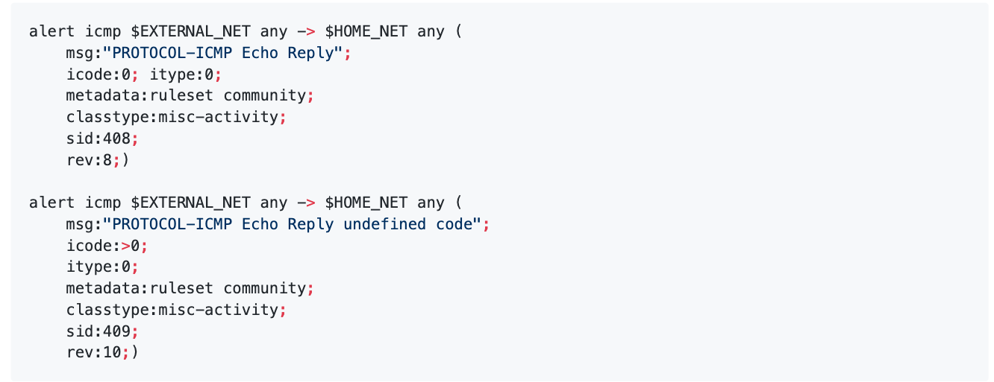
Interpreting Snort Rules
Explain the below ICMP Echo Reply rules. Be sure to identify the:
Action
Protocol
Source/destination addresses
Meaning of each new rule option

Slide 36
Interpreting Snort Rules
Explain the below ICMP Echo Reply rules. Be sure to identify the:
Action: alert
Protocol: icmp
Source/destination addresses: $EXTERNAL_NET any -> $HOME_NET any
Meaning of each new rule option: icode: Checks for a specific ICMP code value.

Slide 37
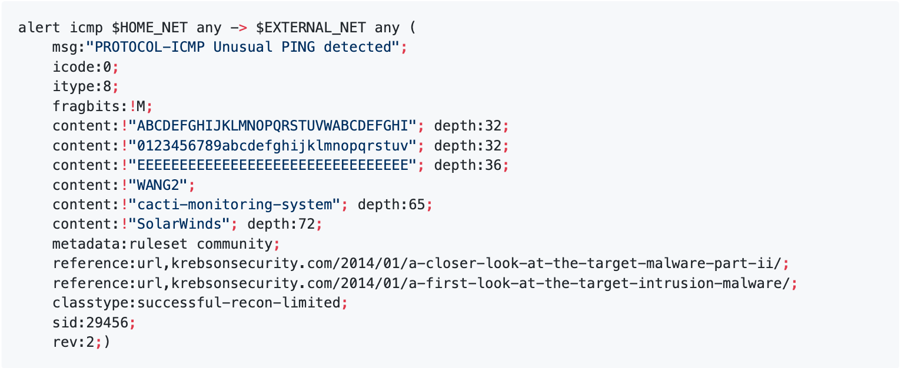
Interpreting Snort Rules
Explain the below ICMP Unusual Ping rule. Be sure to identify the:
Action
Protocol
Source/destination addresses
Meaning of each new rule option

Slide 38
Interpreting Snort Rules
Explain the below ICMP Unusual Ping rule. Be sure to identify the:
Action: alert
Protocol: icmp
Source/destination addresses: $HOME_NET any -> $EXTERNAL_NET any
Meaning of each new rule option:
fragbits: M: Checks if the "More Fragments" fragmentation and reserved headers are set in the IP packet. This flag indicates that this packet is just one in a stream of packets.
reference:url,`: Include a link to relevant documentation.

Slide 39
Interpreting Snort Rules
1. There's an exclamation mark in front of each content string. What does the ! signify?
2. Why do you suppose this rule includes so many?

Slide 40
Interpreting Snort Rules
1. There's an exclamation mark in front of each content string. What does the ! signify?
The ! means to match packets that do not have these contents.
2. Why do you suppose this rule includes so many?
This rule monitors for unusual ping activity. Each content block includes a different trusted string. This rule is a "blanket check" for packets that do not contain these trusted strings.

Slide 41
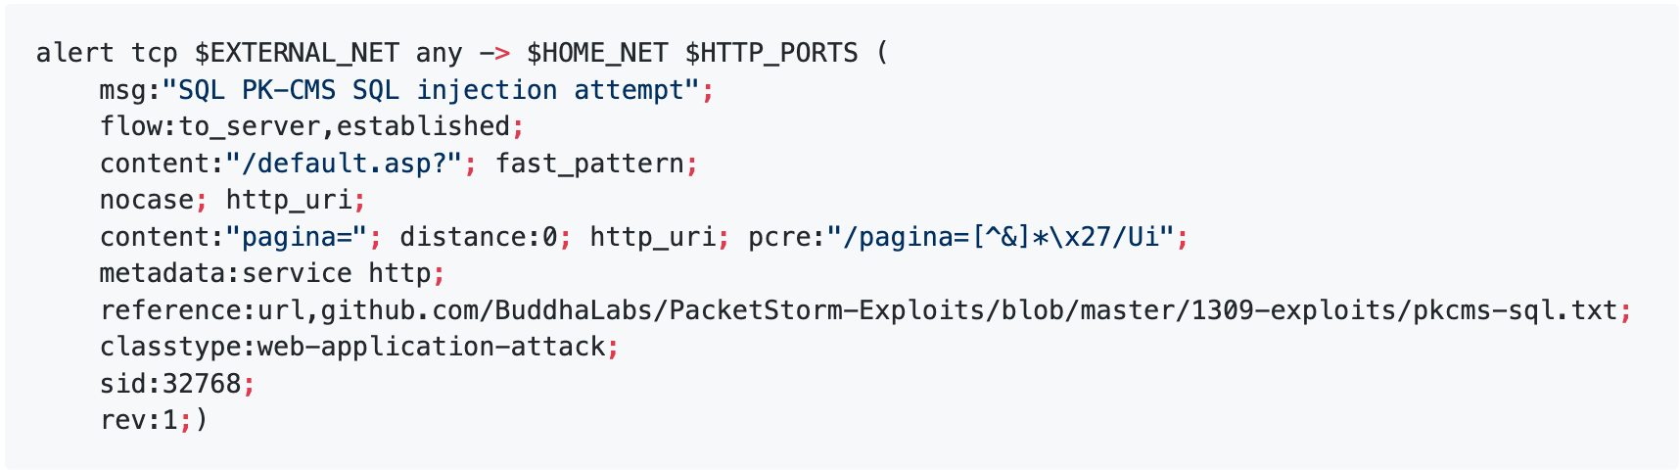
Interpreting Snort Rules
Explain the following rule. Be sure to identify:
Action
Protocol
Source/destination addresses
Meaning of each new rule option

Slide 42
Interpreting Snort Rules
Explain the following rule. Be sure to identify:
Action: alert
Protocol: tcp
Source/destination addresses: $EXTERNAL_NET any -> $HOME_NET $HTTP_PORTS
This watches traffic from the public internet to local https servers.

Slide 43
Interpreting Snort Rules
Meaning of each new rule:
flow:to_server,established: Watches traffic flowing from the public Internet into the server on an established connection. This packet is not a request to initiate a connection, rather it's being transferred over an existing one.
fast_pattern: Enables fast pattern matching.
nocase: Make the search for the content string case-insensitive.
distance:0: Ignore 0 bytes before looking for the content string.
http_uri: Restricts the content search to the HTTP URI field, not the rest of the packet.
pcre`: Allows the rule writer to specify a regular expression, so they can look for multiple patterns in a single rule.

Slide 44
Interpreting Snort Rules
Based on the reference URL, which exploit does this rule monitor for?
Based on your knowledge of SQL injection and the rule above, which of the following carries the SQLi payload? What is the name of the parameter or header that is being attacked?

Slide 45
Interpreting Snort Rules
Based on the reference URL, which exploit does this rule monitor for? This exploit watches for the pkcms-sql exploit.
Based on your knowledge of SQL injection and the rule above, which of the following carries the SQLi payload? What is the name of the parameter or header that is being attacked?
This exploit is delivered via the GET query string, through the parameter pagina.

Slide 47
Malicious Activity

Slide 48
Malicious Activity
When it comes to computer viruses, the best medicine is prevention. But it's hard to keep malware from getting in without knowing what it looks like.
In the next activity, you'll watch a computer get hit with a sophisticated backdoor that gave hackers access to machines at Google, Adobe, and other workplaces back in 2010.

Slide 49
Your Turn: Malicious Activity
In the next activity, you will observer malicious activity and answer the provided questions.
Instructions sent via Slack.
30 Minutes

Slide 50
Malicious Activity

Slide 51
Malicious Activity: Operation Aurora
What is the name of the first resource the client requests from the server?
What is the server's response code for this request?
What is the value of the Location header in that response?

Slide 52
Malicious Activity: Operation Aurora
What is the name of the first resource the client requests from the server?
Filter for http. Note that the first packet is a GET request for /info.
What is the server's response code for this request?
What is the value of the Location header in that response?

Slide 53
Malicious Activity: Operation Aurora
What is the name of the first resource the client requests from the server?
Filter for http. Note that the first packet is a GET request for /info.
What is the server's response code for this request?
The server responds with 302 Moved.
What is the value of the Location header in that response?

Slide 54
Malicious Activity: Operation Aurora
What is the name of the first resource the client requests from the server?
Filter for http. Note that the first packet is a GET request for /info.
What is the server's response code for this request?
The server responds with 302 Moved.
What is the value of the Location header in that response?
The Location header is /info?rFfWELUjLJHpP

Slide 55
Malicious Activity: Operation Aurora
Do you notice anything suspicious about the server's response?
Does it look anything like the HTML you've seen so far? Can you figure out anything about what the code means?

Slide 56
Malicious Activity: Operation Aurora
Do you notice anything suspicious about the server's response?
The query string is suspicious because it strangely resembles a command and control message.
Does it look anything like the HTML you've seen so far? Can you figure out anything about what the code means?

Slide 57
Malicious Activity: Operation Aurora
Do you notice anything suspicious about the server's response?
The query string is suspicious because it strangely resembles a command and control message.
Does it look anything like the HTML you've seen so far? Can you figure out anything about what the code means?
This is JavaScript code, because it's code contained in a <script> tag.
It's obfuscated, meaning the code is purposefully hard to read. You can tell because the first variable name is IwpVuiFqihVySoJStwXmT. Its value looks like a hex-encoded string, but hex decoding doesn't reveal much.
Towards the very bottom, there are some regular expression replacements and a call to eval, likely intended to de-obfuscate the JavaScript and execute the result.

Slide 58
Malicious Activity: Operation Aurora
Immediately after receiving the HTML you just read, the browser sends a request for another file. What is the name of this file?

Slide 59
Malicious Activity: Operation Aurora
Immediately after receiving the HTML you just read, the browser sends a request for another file. What is the name of this file?
The GIF is named infowTVeeGDYJWNfsrdrvXiYApnuPoCMjRrSZuKtbVgwuZCXwxKjtEclbPuJPPctcflhsttMRrSyxl.gif.

Slide 60
Malicious Activity: Operation Aurora
Look at the source/destination addresses for packet 23 and packet 24. What do you notice? Explain what happened with packet 24.
Look at packet 25. What kind of data got sent?

Slide 61
Malicious Activity: Operation Aurora
Look at the source/destination addresses for packet 23 and packet 24. What do you notice? Explain what happened with packet 24.
Packet 23 has src and dst addresses of 192.168.100.202 and 192.168.0.206, respectively. Packet 24 has these addresses reversed. This indicates that 192.168.0.206 is opening a connection to 192.168.0.202.
Look at packet 25. What kind of data got sent?

Slide 62
Malicious Activity: Operation Aurora
Look at the source/destination addresses for packet 23 and packet 24. What do you notice? Explain what happened with packet 24.
Packet 23 has src and dst addresses of 192.168.100.202 and 192.168.0.206, respectively. Packet 24 has these addresses reversed. This indicates that 192.168.0.206 is opening a connection to 192.168.0.202.
Look at packet 25. What kind of data got sent?
These packets follow another TCP handshake between the client and server. If you right-click and select Follow->Stream, you'll see that a payload got sent over the wire—followed by a Windows Shell opened by the Aurora exploit!

Slide 63
Scheduling Backups

Slide 64
Your Turn: Scheduling Backups
In this exercise, you'll create cron jobs to create and update backups.
Instructions sent via Slack.
20 minutes

Slide 65
Scheduling Backups

Slide 66
Scheduling Backups
Write a cron job that creates a bzipped backup of your root directory every Sunday at midnight. It should always save to /var/backups/backup.tar.
Write a cron job to update the backup of the /home directory in the `backup every day at midnight.
What is the correct way to create frequently updated backups?

Slide 67
Scheduling Backups
Write a cron job that creates a bzipped backup of your root directory every sunday at midnight. It should always save to /var/backups/backup.tar.
0 0 0 0 0 tar cvf / /var/backups/backup.tar
or
@weekly tar cvf / var/backups/backup.tar
Write a cron job to update the backup of the /home directory every day at midnight.
What is the correct way to create frequently updated backups?

Slide 68
Scheduling Backups
Write a cron job that creates a bzipped backup of your root directory every sunday at midnight. It should always save to /var/backups/backup.tar.
0 0 0 0 0 tar cvf / /var/backups/backup.tar
or
@weekly tar cvf / var/backups/backup.tar
Write a cron job to update the backup of the /home directory every day at midnight.
@daily tar --update /var/backups/backup.tar /home
What is the correct way to create frequently updated backups?

Slide 69
Scheduling Backups
Write a cron job that creates a bzipped backup of your root directory every sunday at midnight. It should always save to /var/backups/backup.tar.
0 0 0 0 0 tar cvf / /var/backups/backup.tar
or
@weekly tar cvf / var/backups/backup.tar
Write a cron job to update the backup of the /home directory every day at midnight.
@daily tar --update /var/backups/backup.tar /home
What is the correct way to create frequently updated backups?
--update isn't used to create backups because it doesn't update directory content entries, and because it increases the size of the archive each time it's run. Instead, incremental backups should be used.

Slide 70
Any Questions?

